Slide 1
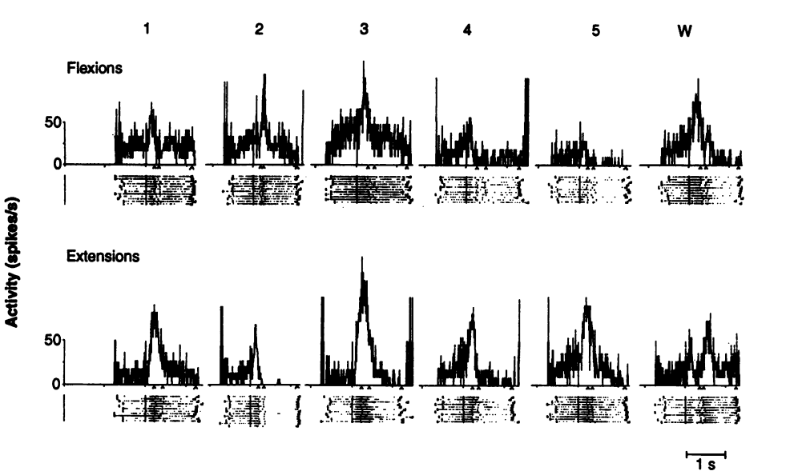
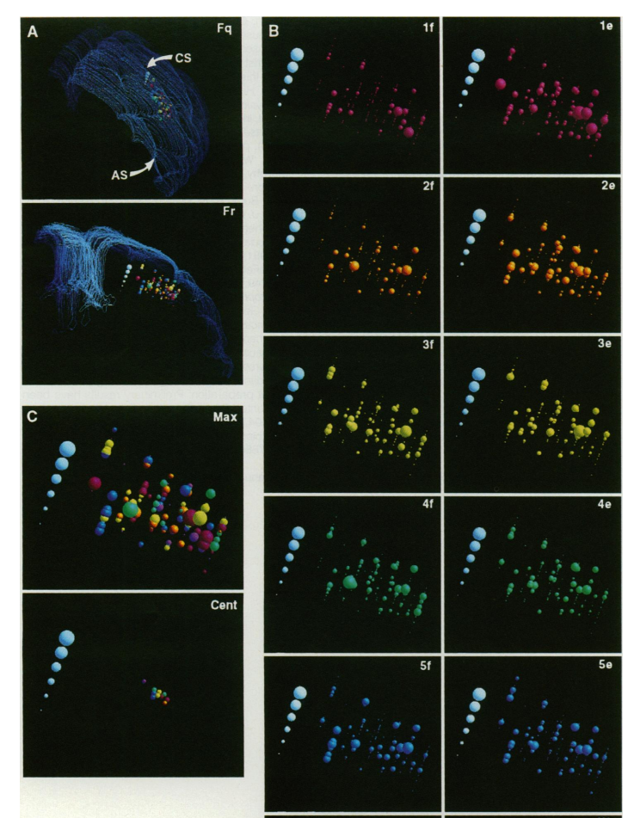
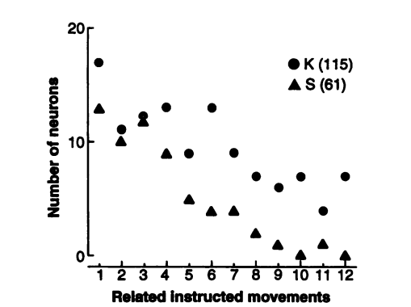
Related-work
How somatotopic is the motor cortex hand area?[J]. Science, 1993.
Contribution：
single motor cortical neurons do not discharge specifically for a particular flexion-extension finger movement but instead are active with movements ofdifferent fingers.
neuronal populations active with movements of different fingers overlap extensively in their spatial locations in the motor cortex.

Slide 2
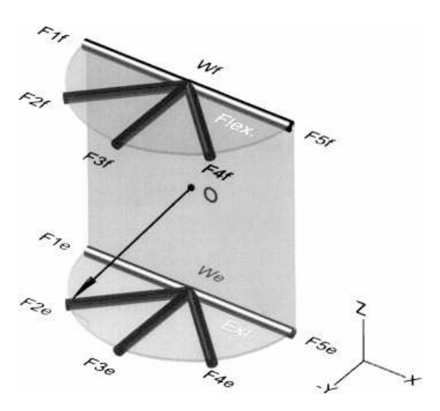
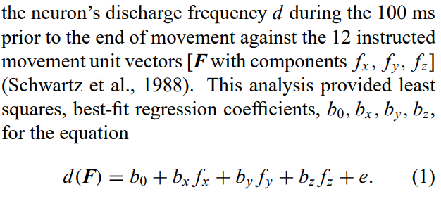
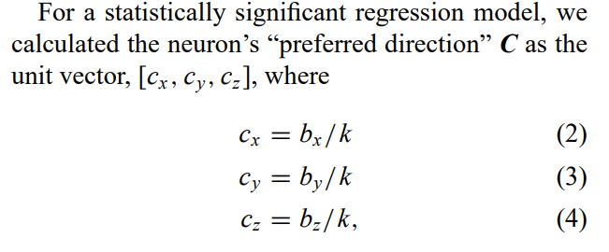
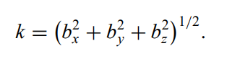
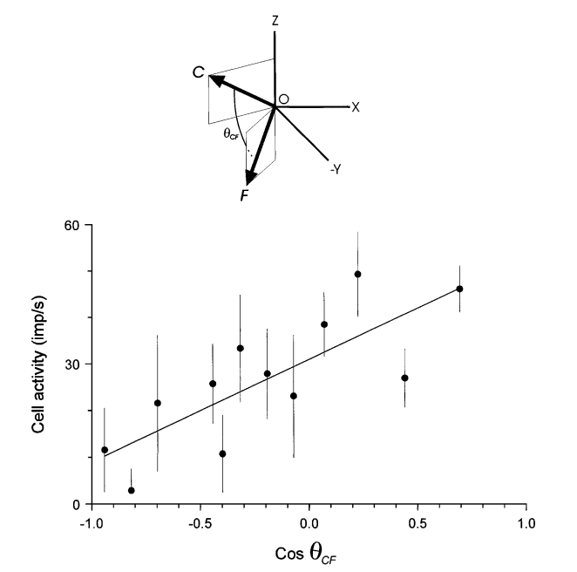
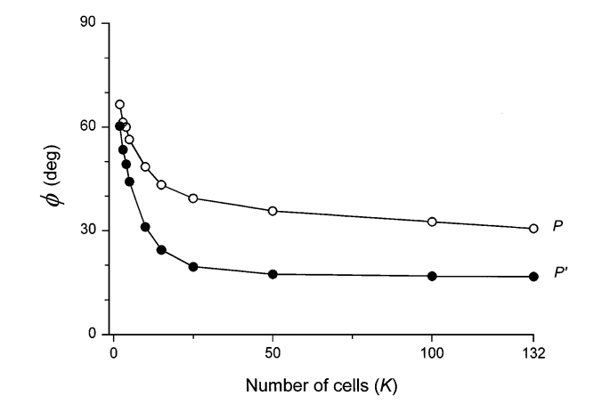
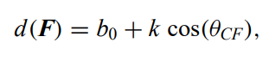
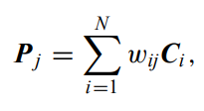
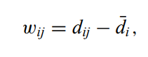
Related-work
Neural coding of finger and wrist movements[J]. Journal of computational neuroscience, 1999
Contribution：
motor cortical neurons related to finger movements was tuned to an abstract, three-dimensional (3D) instructed finger and wrist movement space with hand-like geometry
population vector computed in this space predicted well the instructed finger movement

Slide 3
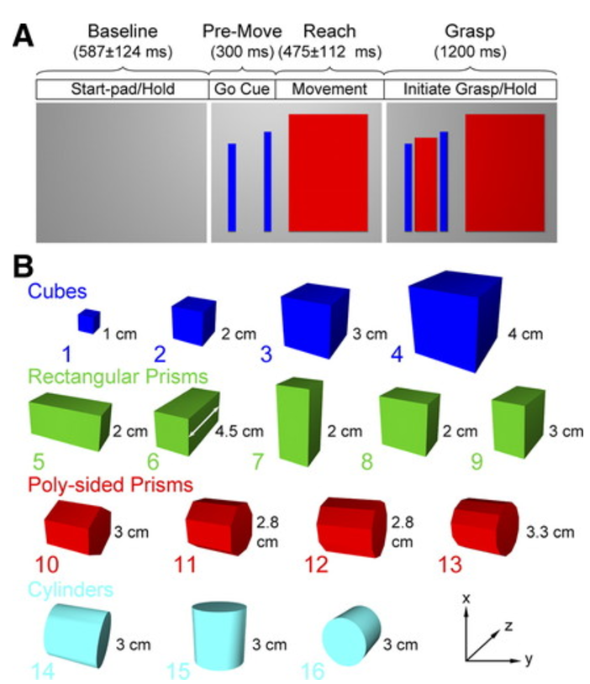
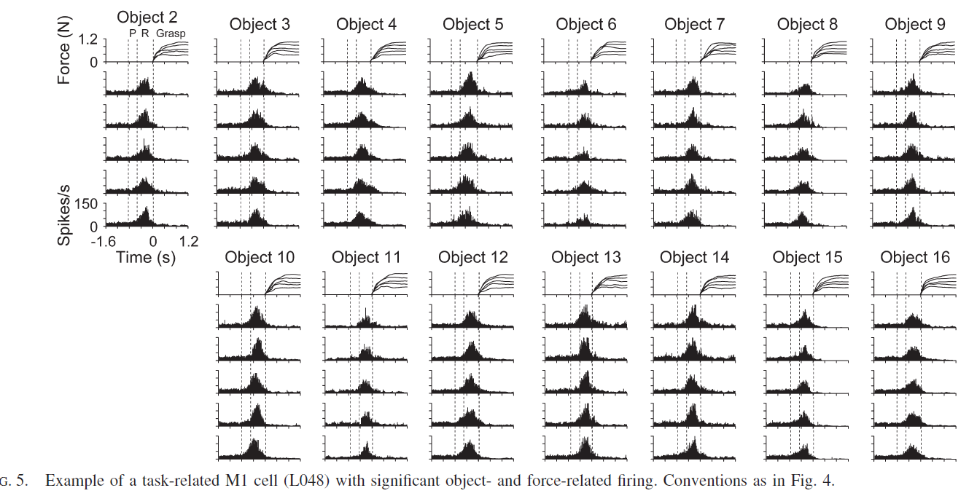
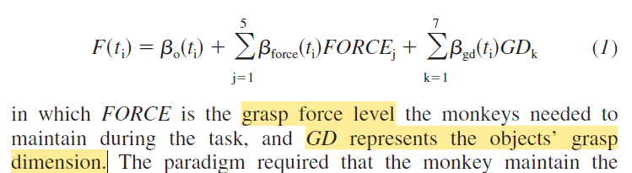
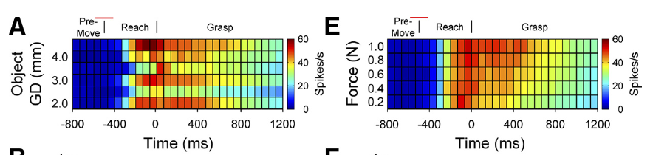
Related-work
Signaling of grasp dimension and grasp force in dorsal premotor cortex and primary motor cortex neurons during reach to grasp in the monkey[J]. Journal of Neurophysiology, 2009.
Contribution：
PMd and M1 neurons modulate their firing in relation to object properties and grasp dimensions during reach-to-grasp tasks
M1 neurons showing stronger correlations with grasp dimension and force

Slide 4
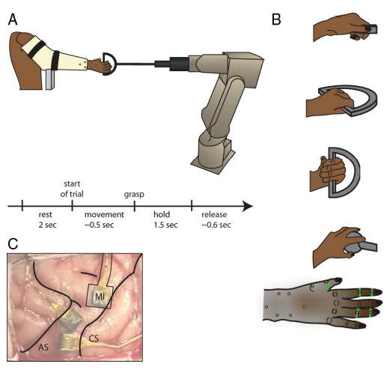
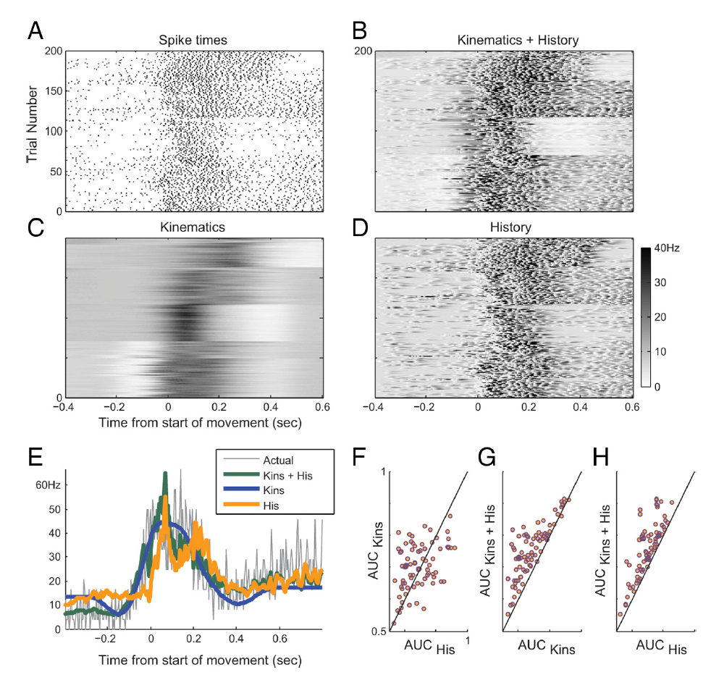
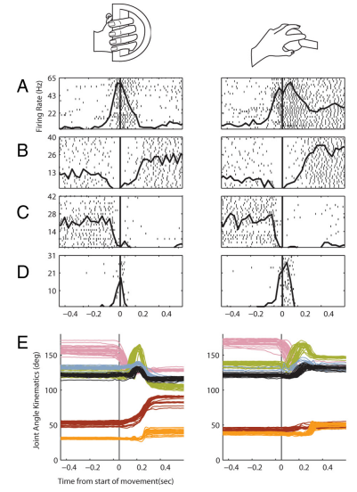
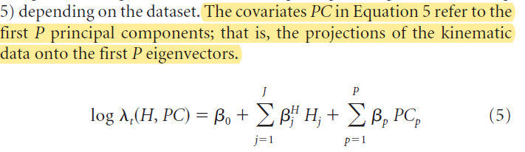
Related-work
Encoding of coordinated grasp trajectories in primary motor cortex[J]. Journal of Neuroscience, 2010
Contribution：
Proposed a generalized linear model framework to predict the firing rate based on its own spiking history and the spatiotemporal kinematics of the joint angles of the hand
Notes:
Encoding of coordinated grasp trajectories in primary motor cortex[J]. Journal of Neuroscience, 2010

Slide 5
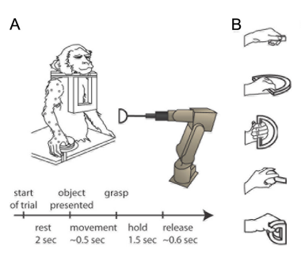
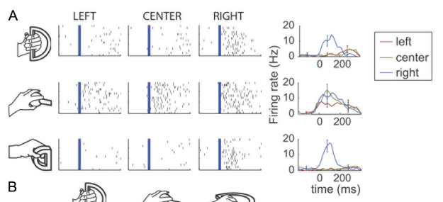
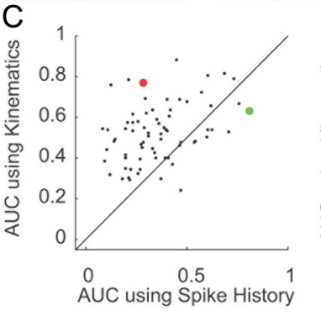
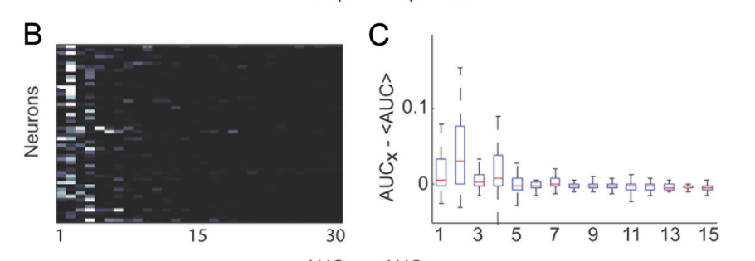
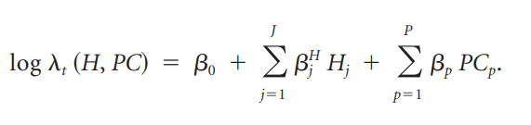
Related-work
Encoding of coordinated reach and grasp trajectories in primary motor cortex[J]. Journal of Neuroscience, 2012
Contribution：
Proposed a generalized linear model framework to predict the firing rate based on its own spiking history and the spatiotemporal kinematics of the joint angles of the hand
The predictive power of a majority of neurons reached a plateau for a model that included only the first five principal components of all the features' trajectories,
Notes:
Encoding of coordinated grasp trajectories in primary motor cortex[J]. Journal of Neuroscience, 2010

Slide 6
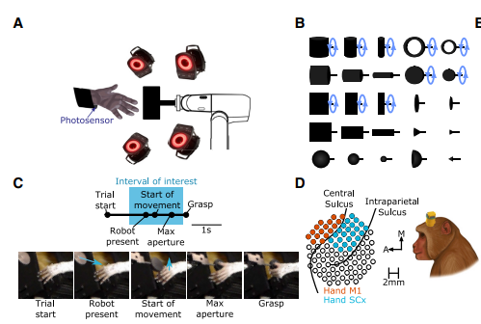
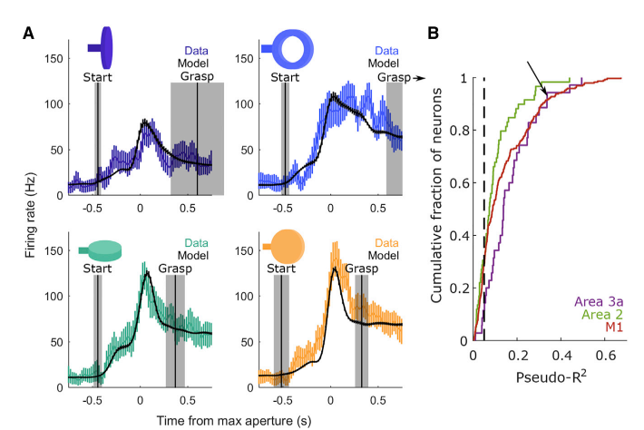
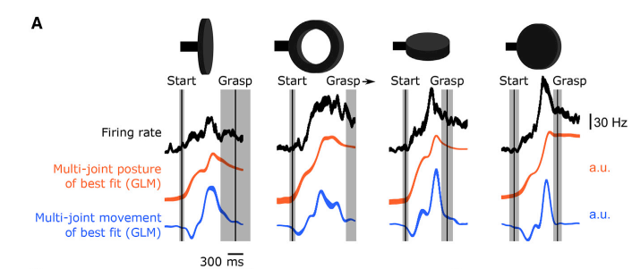
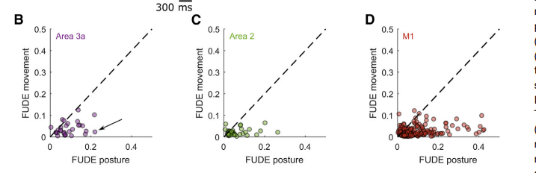
Related-work
Postural representations of the hand in the primate sensorimotor cortex[J]. Neuron, 2019, 104(5):
Contribution：
The response fields of sensorimotor neurons are distributed over the entire hand
For grasping, unlike reaching, neurons track joint angles rather than joint velocities

Slide 7
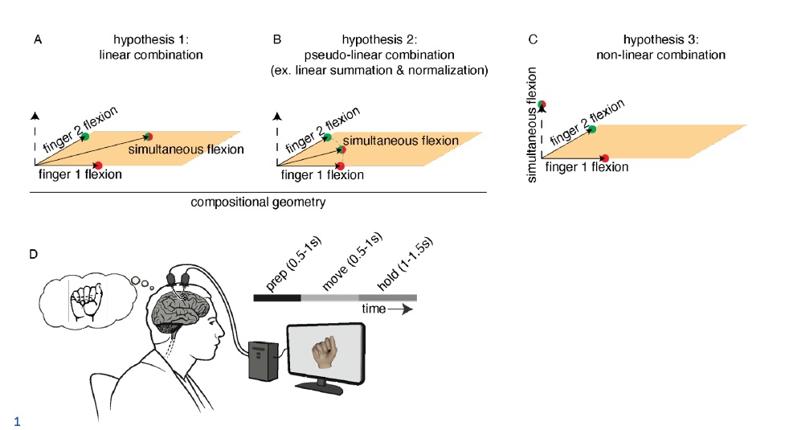
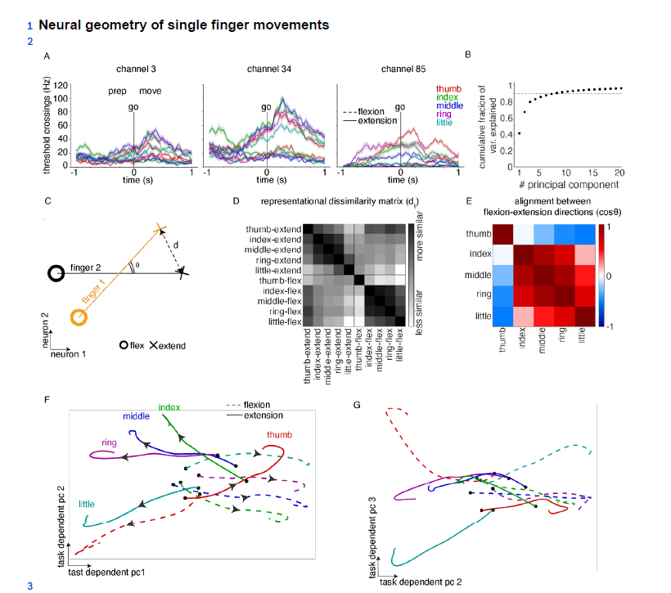
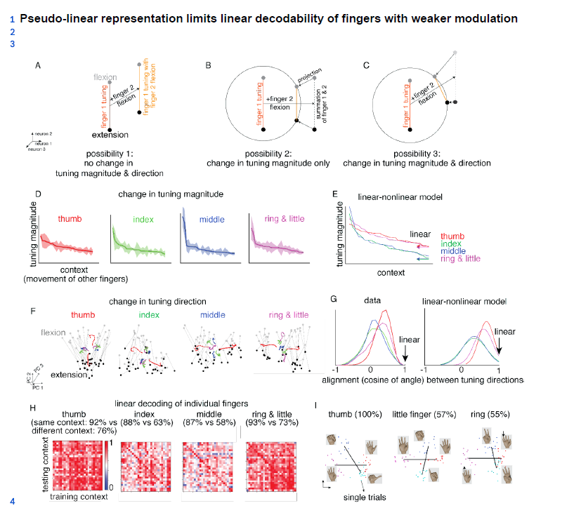
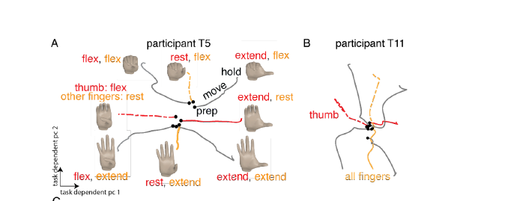
Related-work
Pseudo-linear Summation explains Neural Geometry of Multi-finger Movements in Human Premotor Cortex-2023
Contribution：
The motor cortex combines simple movements into complex ones through a pseudo-linear summation of individual finger movements, with deviations such as normalization of neural activity and changes in tuning direction for weakly represented fingers

Slide 8
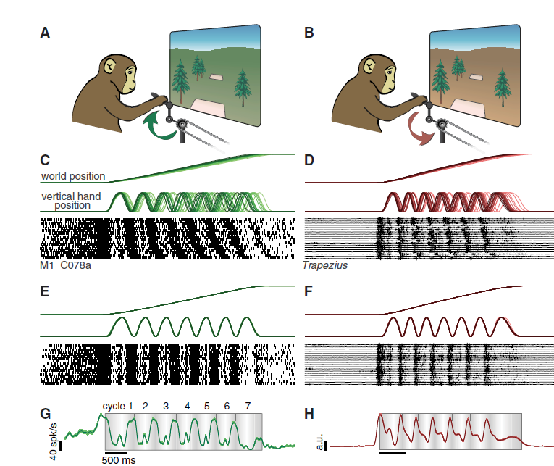
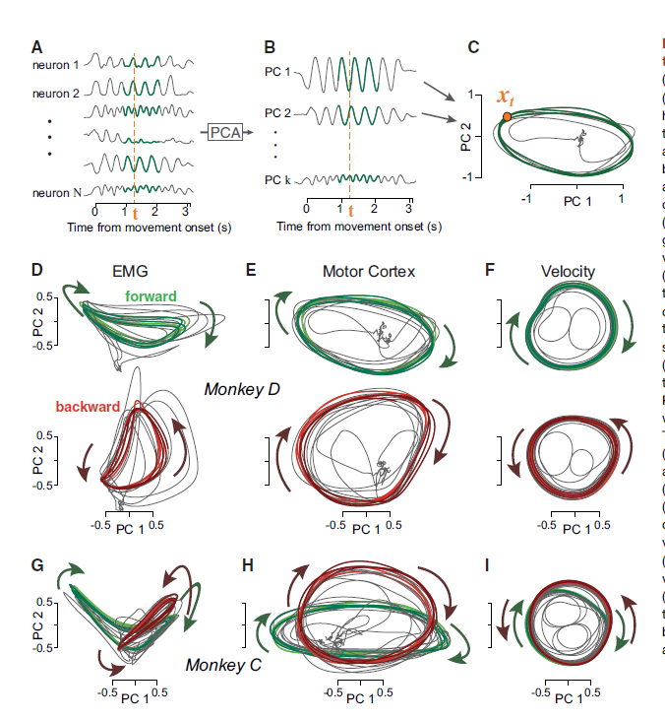
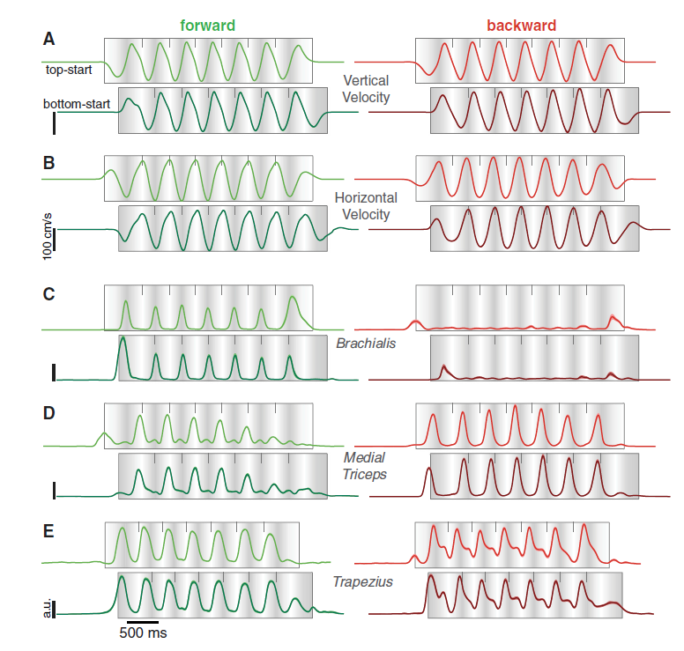
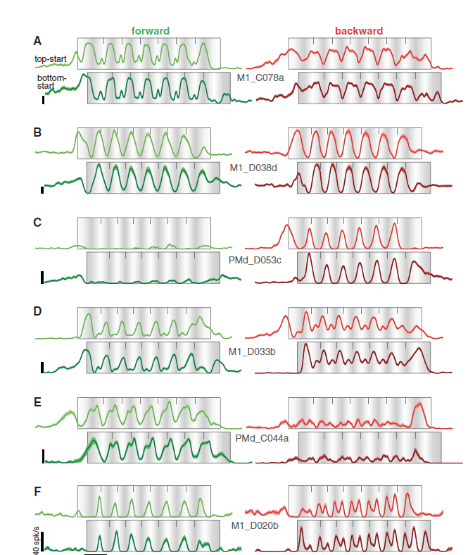
Related-work
Motor cortex embeds muscle-like commands in an untangled population response[J]. Neuron, 2018
Contribution：
while primate motor cortex activity exhibits muscle-like properties at the level of individual neurons, the overall structure of population activity avoids "tangling" to ensure noise robustness
Muscle-like commands in the cortex are embedded in additional structured patterns, enabling the prediction of motor cortex activity from muscle activity.

Slide 9
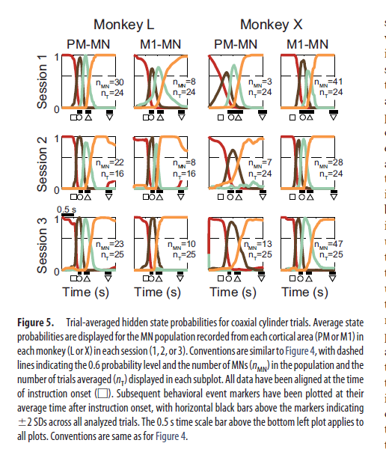
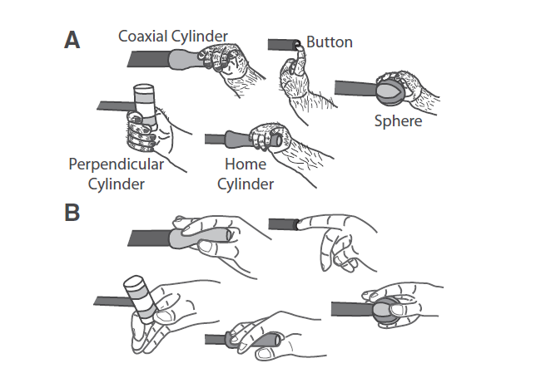
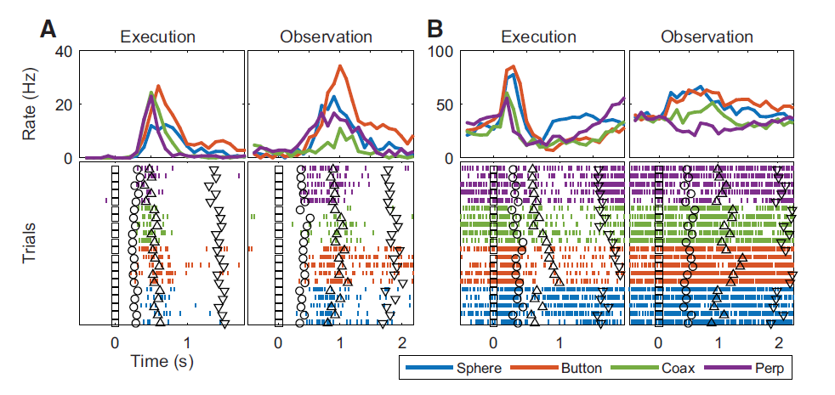
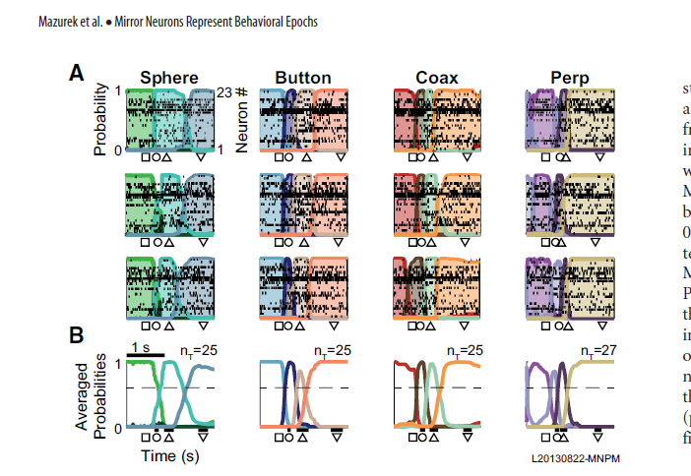
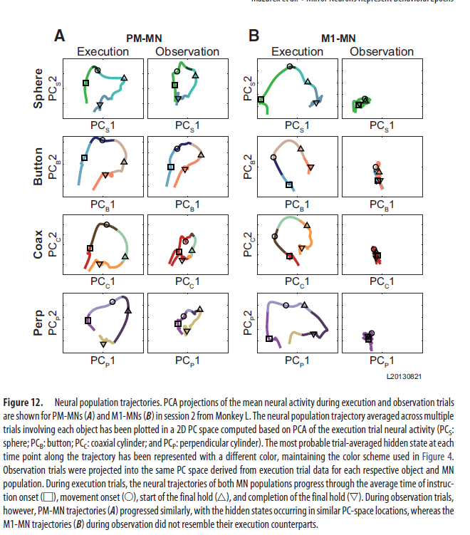
Related-work
Mirror neuron populations represent sequences of behavioral epochs during both execution and observation[J]. Journal of Neuroscience, 2018
Contribution：
mirror neurons (MNs) in the premotor cortex encode sequential hidden neural states that correspond to behavioral epochs of action
the similarity of hidden state sequences during action execution and observation may facilitate understanding others' actions without direct performance..

Slide 10
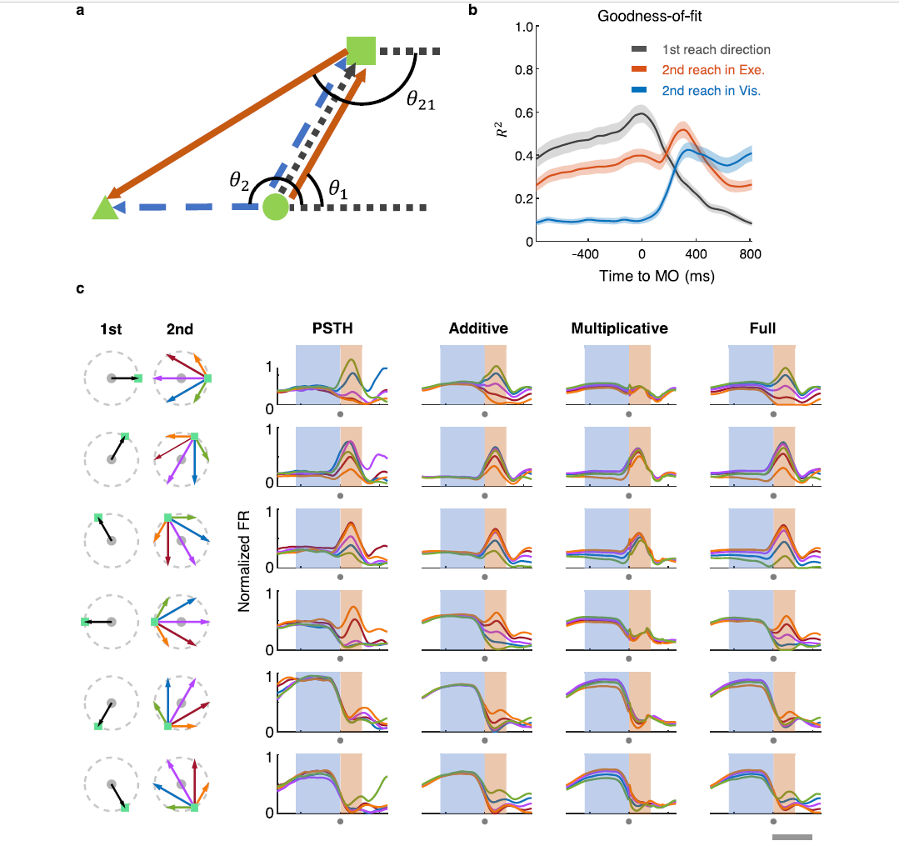
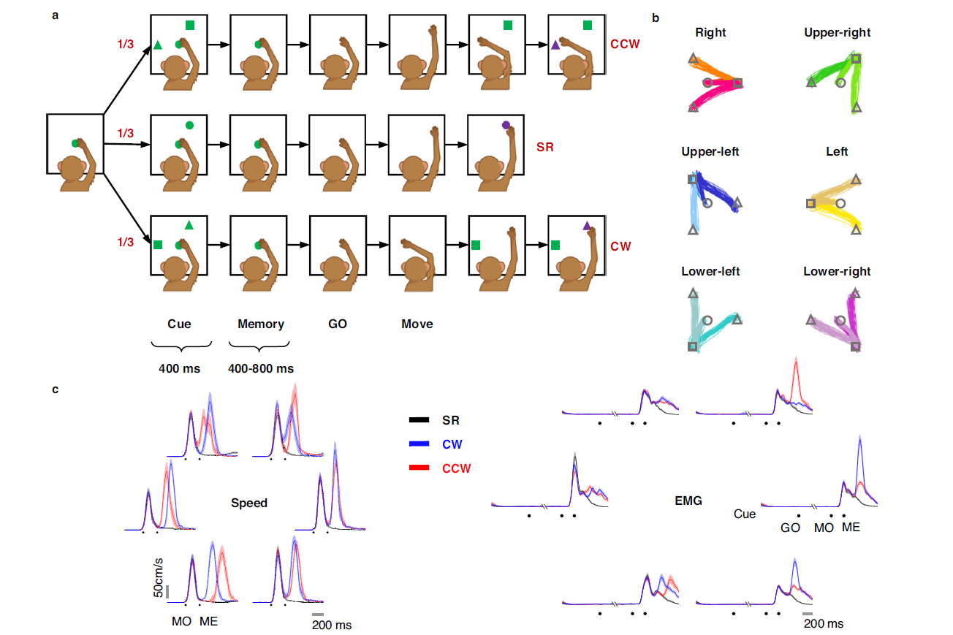
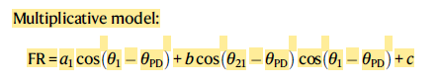
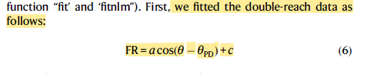
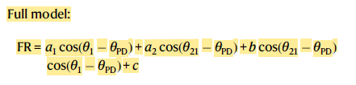
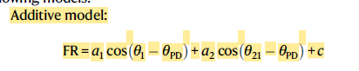
Related-work
Multiplicative joint coding in preparatory activity for reaching sequence in macaque motor cortex[J]. Nature Communications, 2024
Contribution：
motor cortex activity during a double-reach task transitions from a multiplicative joint coding during preparation, reflecting impending and subsequent movements, to an additive coding during execution

Slide 11
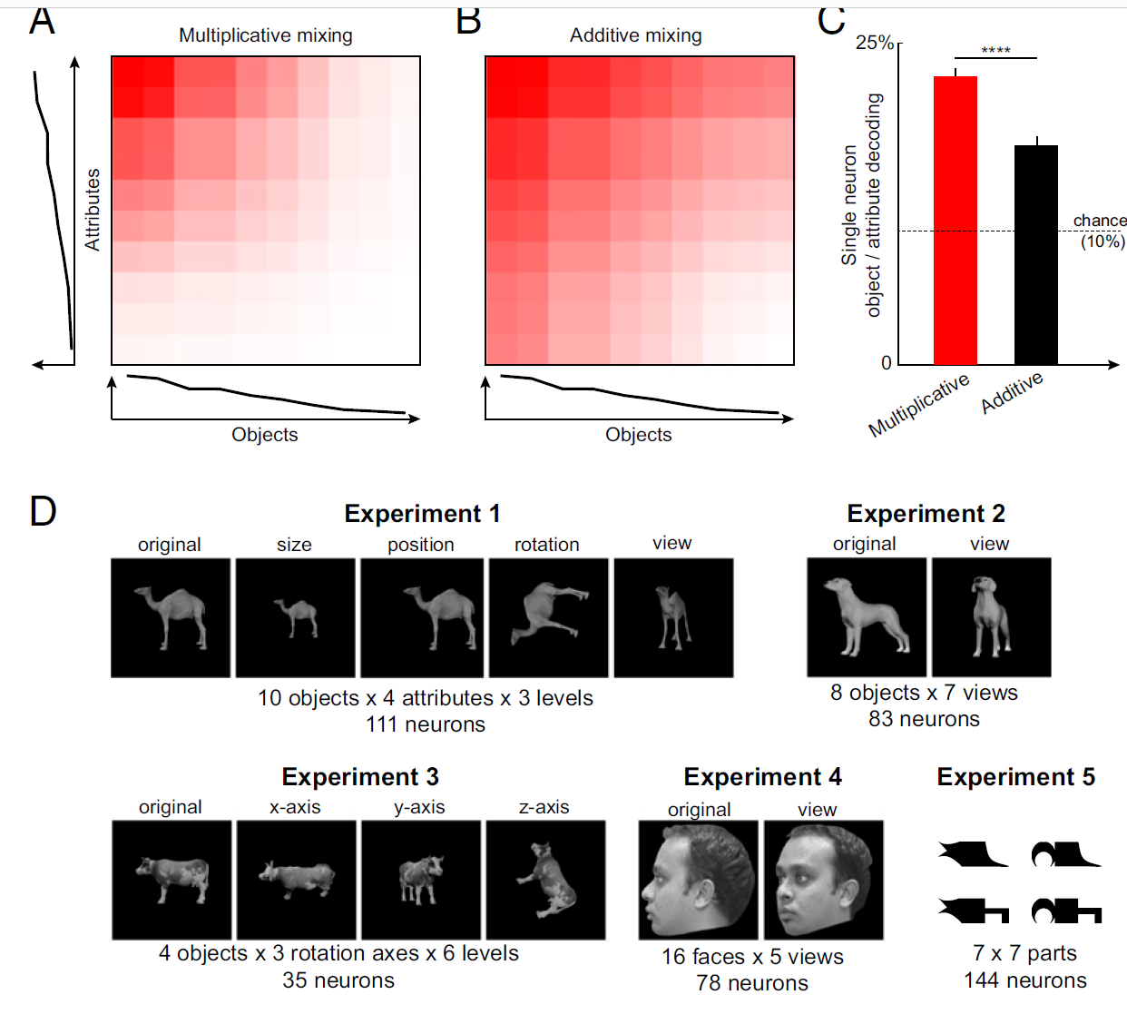
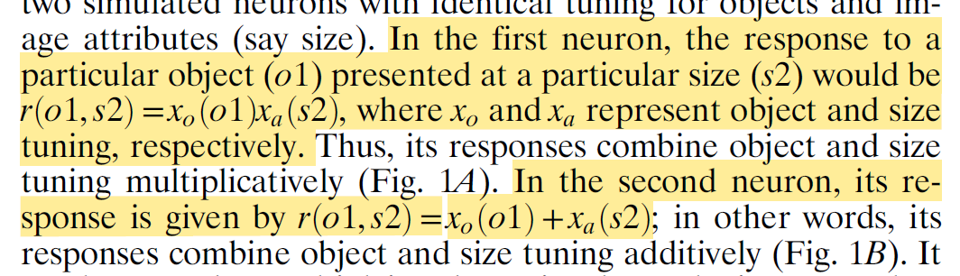


Related-work
Multiplicative mixing of object identity and image attributes in single inferior temporal neurons[J]. Proceedings of the National Academy of Sciences, 2018
Contribution：
In high-level visual cortex, single neurons can be explained better as a product rather than a sum of tuning for object identity and tuning for image attributes
This make better neural population decoding of object identity and image attributes

Slide 12





Related-work
Neural basis for hand muscle synergies in the primate spinal cord[J]. Proceedings of the National Academy of Sciences, 2017
Contribution：
spinal premotor interneurons, rather than the corticomotoneuronal pathway, underlie muscle synergy patterns during hand movements in primates
older premotor circuits provide synergistic control, with more fractionated control added by the corticomotoneuronal system.

Slide 13




Related-work
Sequential and efficient neural-population coding of complex task information[J]. Neuron, 2022
Contribution：
Neural circuits in the organize multiple interrelated task variables using less-correlated neural population modes
The encoding process involves partial whitening of task-specific information, where different variables are represented with varying signal-to-noise levels.
Neural circuits can implement time-dependent encodings using random sequential dynamics as a temporal scaffold

